Slide 1
Time Speed And Distance

Slide 2
BASIC RELATIONS :
Let's foremost learn the definition of distance and time.
Distance: The numerical description of “How far two objects” is called distance. It may also refer to the length between two points that may be present or may get created.
Time: It is a component to compare the “durations of events” and the “intervals” between them and to quantify the motions of objects.
So, what is speed?
Suppose a man walks a distance of 10 kilometres and he takes 2 hours to walk the distance, the speed of the man is defined as the distance travelled by him in unit time. Here, we can say that the man travels 5 kilometres for every hour thereby completing the journey of 10 kilometres in 2 hours. The speed of the man is the rate at which he travels the specified distance.

Slide 3
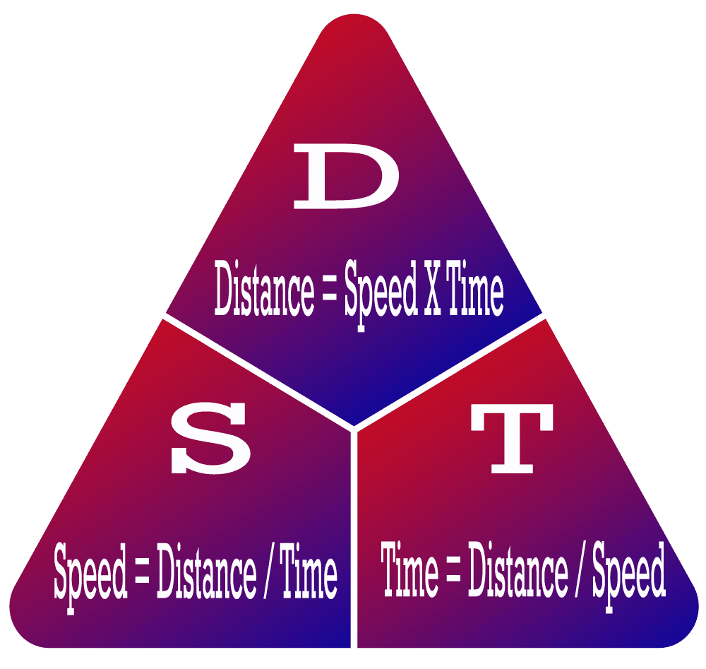
The 3 formulas for Speed, Time & Distance:

Slide 4
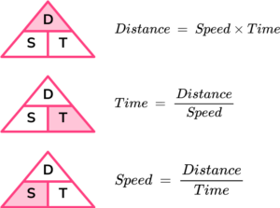

Slide 5
Time problem
We can solve problems involving time by remembering the formula for speed, distance and time.
Example:
Calculate the time if a car travels at 15 miles at a speed of 36 mph.
Time = distance ÷ speed
Time = 15 ÷ 36 = 0.42 hours
0.42 ✕ 60 = 25.2 minutes
Example:
A train travels 42km between two stops at an average speed of 36 km/h.
If the train departs at 4 pm, when does the train arrive?
Time = distance ÷ speed
Time = 42 ÷ 36 = 1.17 hours
1.17 ✕ 60= 70 minutes = 1 hour 10 minutes.

Slide 6
Example:
The average speed of a scooter is 18 km/h and the average speed of a cycle is 10 km/h. When both have travelled 99 km what is the difference in the time taken?
Solution:
Time = distance ÷ speed
Time A = 99 ÷ 18 = 5.5 hours
Time B= 99 ÷ 10 = 9.9 hours
Difference in time = 9.9 – 5.5 = 4.4 hours
4.4 hours = 4 hours and 24 minutes

Slide 7
UNITS OF SPEED AND THEIR CONVERSION
Standard Units
The standard units of speed are as follows.
Unit Symbols
metres per second m/s
kilometres per hour km/h
miles per hour m/h
1 kilometre = 1000 metres
1 mile = 1.60934 kilometres or 1.6 kilometres
1 hour = 3600 seconds
Conversion of units from km/h to m/s and vice versa
1 km/h = 1000m / 3600s = 5m / 18s
So,
1 km/h = 5/18 m/s and 1 m/s = 18/5 km/h
1 km/h = 50/3 m/min and 1 m/min = 3/50 km/h

Slide 8
Example: A train 400 m long takes 20 seconds to completely cross a pole. Find its speed.
(a) 54 kmph
(b) 36 kmph
(c) 72 kmph
(d) 108 kmph

Slide 9
PROPORTIONALITY :
Distance is constant, Speed and Time are inversely proportional
As Speed is inversely proportional to Time
Therefore If Speed increases Time of the journey decreases
Or
If Speed decreases then Time of the journey increases

Slide 10
A car travelling with 5/7 of its actual speed covers 42 km in 1 hr 40 min 48 sec. Find the actual speed of the car
Time taken = 1 hr 40 min 48 sec = 1 hr 40 4/5 min = 126/75 hrs Let the actual speed be A km/hr. S=D/T S*T=D Then (5/7) * A*(126/75) = 42 A= 35km/hr

Slide 11
Example: A person covers a certain distance at a certain speed. If he decreases his speed by 20%, then he takes 16 minutes more to cover the same distance. Find the time taken by him to cover the distance at original speed.

Slide 12
(ii) Time is constant, Speed and Distance are directly proportional
Therefor, Faster the speed more will be the distance travelled
OR
Slower the speed less will be the distance travelled

Slide 13
If a person walks at 14 km/hr instead of 10 km/hr, he would have walked 20 km more. The actual distance should be travelled by him is:

Slide 14
If a person walks at 14 km/hr instead of 10 km/hr, he would have walked 20 km more. The actual distance should be travelled by him is:
Let the actual distance travelled be x km.
Then, x/10 = (x+20) / 14
⇒14x=10x+200
⇒4x=200
⇒x=50km

Slide 15
(iii) Speed is constant, Time and Distance are directly proportional
Like Distance is directly proportional to Time
Therefore, if the distance travelled increases time also increases
OR
if the distance travelled decreases time also decreases

Slide 16

AVERAGE SPEED
What is the Average Speed Formula?
The average speed of a body is equal to the total distance covered, divided by the total time taken. The average speed formula is expressed as follows:
Average Speed Formula

Slide 17
Average Speed Formula with Two Speeds
The average speed formula with two speeds can be calculated after adding the total distance and dividing it by the total time taken to cover that distance.
Now, if two speeds are given along with the time taken by them, we will have to find the two distances.
We find the distance covered by using the formula, Distance = Speed × Time.
After this, we add the two distances and divide it by the total time.
Let us understand this with the help of an example.
Example: During a journey, a train moves at a speed of 50 kilometers per hour for the first 2 hours and 70 kilometers per hour for the next 3 hours. Find the average speed of the train using the average speed formula.
Solution:
We know that the train moves at a speed of 50 kilometers per hour for the first 2 hours. So, speed₁ = 50, time₁ = 2
And the train moves at a speed of 70 kilometers per hour for the next 3 hours. So, speed₂ = 70, time₂ = 3

Slide 18
We will use the following steps to solve the question.
First, we will the Distance₁ and Distance₂ separately using the formula, Distance = Speed × Time.
We know that total distance = (Distance₁ + Distance₂)
We know that total time = (Time₁ + Time₂)
Average Speed Formula = Total Distance/Total Time
Average Speed = (Distance₁ + Distance₂) ÷ (Time₁ + Time₂)
Applying all these steps together we get,
Average Speed = (50 × 2 + 70 × 3) ÷ (2 + 3)
= (310) ÷ (5) = 62 kilometer/hour
Therefore, the average speed of the train is 62 kmph.

Slide 19
John travelled 30 𝑘𝑚30 km in 9090 minutes. Nadine travelled 52.5 𝑘𝑚52.5 km in 2.52.5 hours.
Who had the greater average speed?

Slide 20
A car covers a certain distance at a speed of 90 km/hr while going and returns to the starting point at a speed of 60 km/hr. Find the average speed of the car for the whole journey.?

Slide 21
A man covers a certain distance between his house and office on bike. Having an average speed of 30 km/hr, he is late by 10 minutes. However, with a speed of 40 km/hr, he reaches his office 5 minutes earlier. Find the distance between his house and office?
METHOD 2
Speed Ratio = 3 : 4
Time Ratio = 4 : 3
diff = 1 part
= 15 min
Hence time taken
= 60 min & 40 min
Distance = S*T
=> 30*1 = 30 km
METHOD 1
Difference in time;
10+5 = 15 minutes => 15/60 hours
=> 0.25 hours
The required distance
= (30×40)x0.25/(40-30) = 30 km

Slide 22
A worker reaches his work place 20 minutes late by walking at 3 km/h. The next day he increases his speed by 2 km/h and reaches on time. Find the distance from his house to his work place

Slide 23

Finding Speed or Time Required after Crossing Each Other:
Application:
If two persons or trains A and B start their journey at the same time from two points P and Q towards each other and after crossing each other they take a and b hours in reaching Q and P respectively, then
Note: Using this relationship you can find out the missing variables which can be either speed or time. Once these are known you can easily find the distance.

Slide 24
Two, trains, one from Howrah to Patna and the other from Patna to Howrah, start simultaneously. After they meet, the trains reach their destinations after 9 hours and 16 hours respectively. The ratio of their speeds is:
Solution:
The ratio of their speed is √16/√9 = 4/3 or 4:3

Slide 25
Practice Questions:
Gopal travelled first half of his journey time at an average speed of 40 kmph and the remaining half at an average speed of 50 kmph. Find his average speed for the journey.
42 kmph
45 kmph
48 kmph
Cannot be determined

Slide 26
2. Bala travelled for 2 hours at 40 kmph and then for 3 hours at 60 kmph. Find his average speed.
(a) 44 kmph
(b) 52 kmph
(c) 62 kmph
(d) 64 kmph

Slide 27
3. Gopal travelled first half of his journey time at an average speed of 40 kmph and the remaining half at an average speed of 50 kmph. Find his average speed for the journey.
42 kmph
45 kmph
48 kmph
Cannot be determined

Slide 28
4. A person has to cover a distance of 6 km in 45 minutes. If he covers one-half of the distance in two-thirds of the total time; to cover the remaining distance in the remaining time, what should be his speed in km/hr?
10 km/hr
12 km/hr
15 km/hr
None
Ans: B

Slide 29
5. If a man travelled at 3/4th of his usual speed, then the time taken in this case is how many times the usual time?
3/4
4/3
3/5
Cannot be determined

Slide 30
6. The ratio of the speeds of P, Q and R is 3 : 4 : 6. Find the ratio of the times that P, Q and R would take to run a certain distance.
4 : 3 : 1
2 : 3 : 4
3 : 2: 4
4 : 3 : 2

Slide 31
7. While driving from Chennai to Bangalore, I covered half of the journey at an average speed of 80 kmph, half of the 2nd half of the journey at an average speed of 40 kmph and the rest at 60kmph. It took 5 hours and 30 minutes to reach Bangalore. How far is Bangalore from Chennai?
310 km
350 km
330 km
360 km

Slide 32
8. The distance from my house to my friends house is 12 km. I walked at a speed of 4 km/h and after every kilometre took rest for 10 minutes. How much time did it take for me to reach my friend’s house?
3 hours
4 hours and 50 minutes
5 hours
None of these

Slide 33
9. Rajat had covered one-third of the total distance of his trip when his scooter failed. He then parked it and covered the remaining distance on foot, walking twenty times as much time as riding. What is the ratio of his riding speed to his walking speed?
20
19
10
9

Slide 34
10. A car takes 2 hours more to cover a distance of 480 km when its speed is reduced by 8 km/h. Find its usual speed.
48 km/h
55 km/h
60 km/h
64 km/h

Slide 35
11. By walking at 3/7th of his usual speed, a man reaches office 20 minutes later than usual time. What is his usual travel time?
10 min
15 min
20 min
25 min
Ans: B

Slide 36
12. A man started 15 minutes late and by travelling at a speed which is 5 / 4 th of his usual speed reached his office 20 minutes early. What is the usual time of his journey?
85 minutes
100 minutes
135 minutes
175 minutes

Slide 37
13. Two buses travel to a place at 45 km/h and 60 km/h respectively. If the second bus takes 5 1/2 hours less than the first for the journey, the length (all in km) of the journey is
900
945
990
1350
Ans: C

Slide 38
14. If I walk at 30 miles/hr I reach 1 hour before the reporting time and if I walk at 20 miles/hr I reach 1 hour late. Find the distance between 2 points and the exact time of reaching destination is 11 am then find the speed with which I have to walk to reach on time.
100miles and 24 miles/hr
120miles and 24 miles/hr
120miles and 16 miles/hr
100miles and 16 miles/hr
Ans: B

Slide 39
15. Cars X and Y started from A with speeds in the ratio 4 : 5 at 9.00 am and 10.00 am respectively. If both the cars travelled in the same direction, find the ratio of the distances that X and Y would have covered before meeting.
1 : 1
2 : 1
1 : 2
3 : 2

Slide 40
